Slide 1

The Great Pizza Analytics Challenge
Suryaprakash | Data Analyst
Transforming raw pizza sales data into actionable business intelligence using MySQL

Slide 2

Project Overview
Purpose & Vision
IDC Pizza needed a comprehensive analysis of their sales data to drive strategic business decisions. This project transformed raw transactional data into meaningful insights using structured SQL analytics.
Key Objectives
Identify sales trends and patterns across time periods
Evaluate category and product performance
Analyze pricing structures and revenue optimization
Discover menu gaps and underperforming items
SQL served as the primary tool for data extraction, transformation, and analysis—enabling efficient querying of complex relationships across multiple tables to generate business intelligence.

Slide 3

Database Schema Architecture
orders
order_details
Core transaction records
Line-item specifics
order_id (Primary Key)
order_details_id (PK)
date
order_id (FK)
time
pizza_id (FK)
quantity
pizzas
pizza_types
Product inventory
Product master data
pizza_id (PK)
pizza_type_id (PK)
pizza_type_id (FK)
name
size
category
price
ingredients
Four interconnected tables create a normalized relational structure, enabling complex queries across orders, products, and categories while maintaining data integrity.

Slide 4
Tools & Technical Skills
MySQL Database
Advanced Joins
Primary database management system for storing, querying, and analyzing pizza sales data across multiple normalized tables.
INNER, LEFT, and RIGHT joins to combine data across orders, order details, pizzas, and pizza types for comprehensive analysis.
Aggregation Functions
Filtering Techniques
SUM, AVG, COUNT, and statistical functions to calculate totals, averages, and performance metrics across categories and time periods.
LIKE, BETWEEN, IN, AND/OR operators for precise data extraction based on dates, prices, sizes, and keywords.
Data Quality Management
Advanced Grouping
NULL handling, data cleaning, and validation techniques to ensure accurate analysis and reliable business insights.
GROUP BY, HAVING clauses, and SELF JOIN operations for complex aggregations, filtering, and comparative analysis.

Slide 5
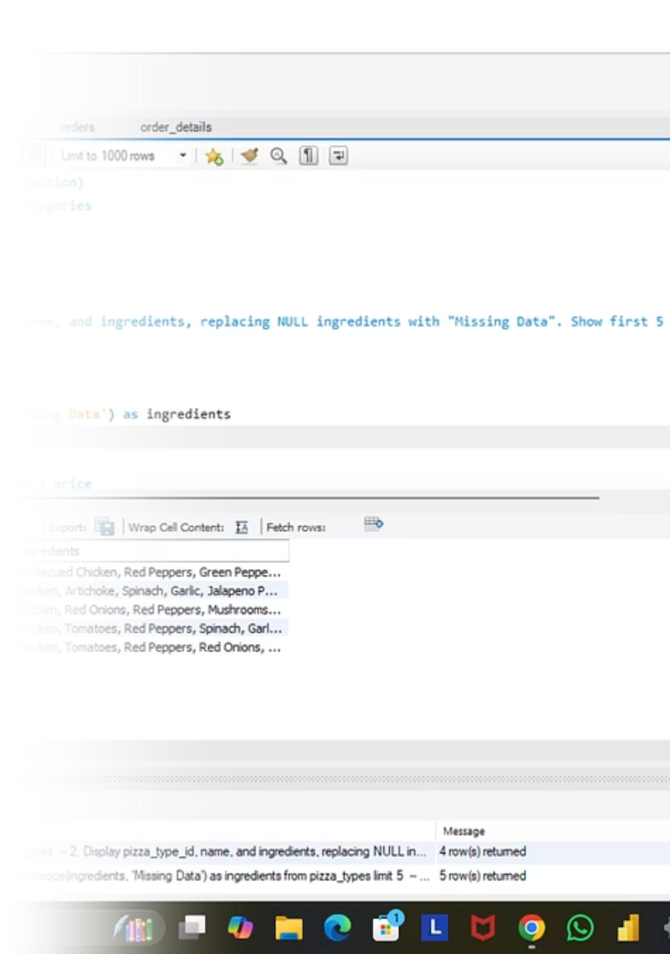



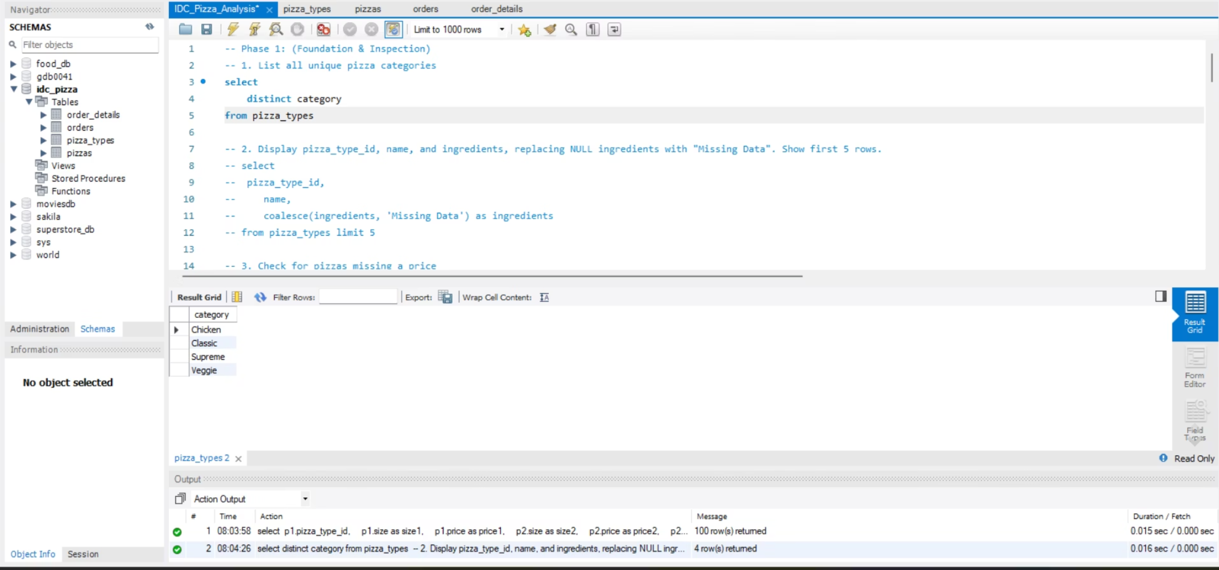
Challenge Tasks: Three-Phase Analytics Journey
Phase 1: Foundation & Inspection
Database structure review, table relationships, row counts, column data types, NULL value detection, and initial data quality assessment.
Phase 2: Filtering & Exploration
Date-based queries, price range filtering, size-specific analysis, keyword searches, category exploration, and pattern identification.
Phase 3: Sales Performance
Revenue calculations, quantity analysis, category comparisons, pricing patterns, order value metrics, and performance benchmarking.

Slide 6
Filtering & Exploration Insights
Orders by Date
Price Range Analysis
Size-Based Insights
Temporal analysis revealed ordering patterns, peak sales periods, and seasonal fluctuations critical for inventory and staffing decisions.
Filtered pizzas in the ₹15–₹17 range to identify mid-tier pricing performance and customer preferences in this segment.
Large and XL pizzas showed distinct ordering patterns, informing size-specific promotions and pricing strategies for premium offerings.
Keyword Filtering: Targeted searches for "Chicken" pizzas helped identify popular flavor profiles and ingredient preferences, guiding menu optimization strategies.

Slide 7
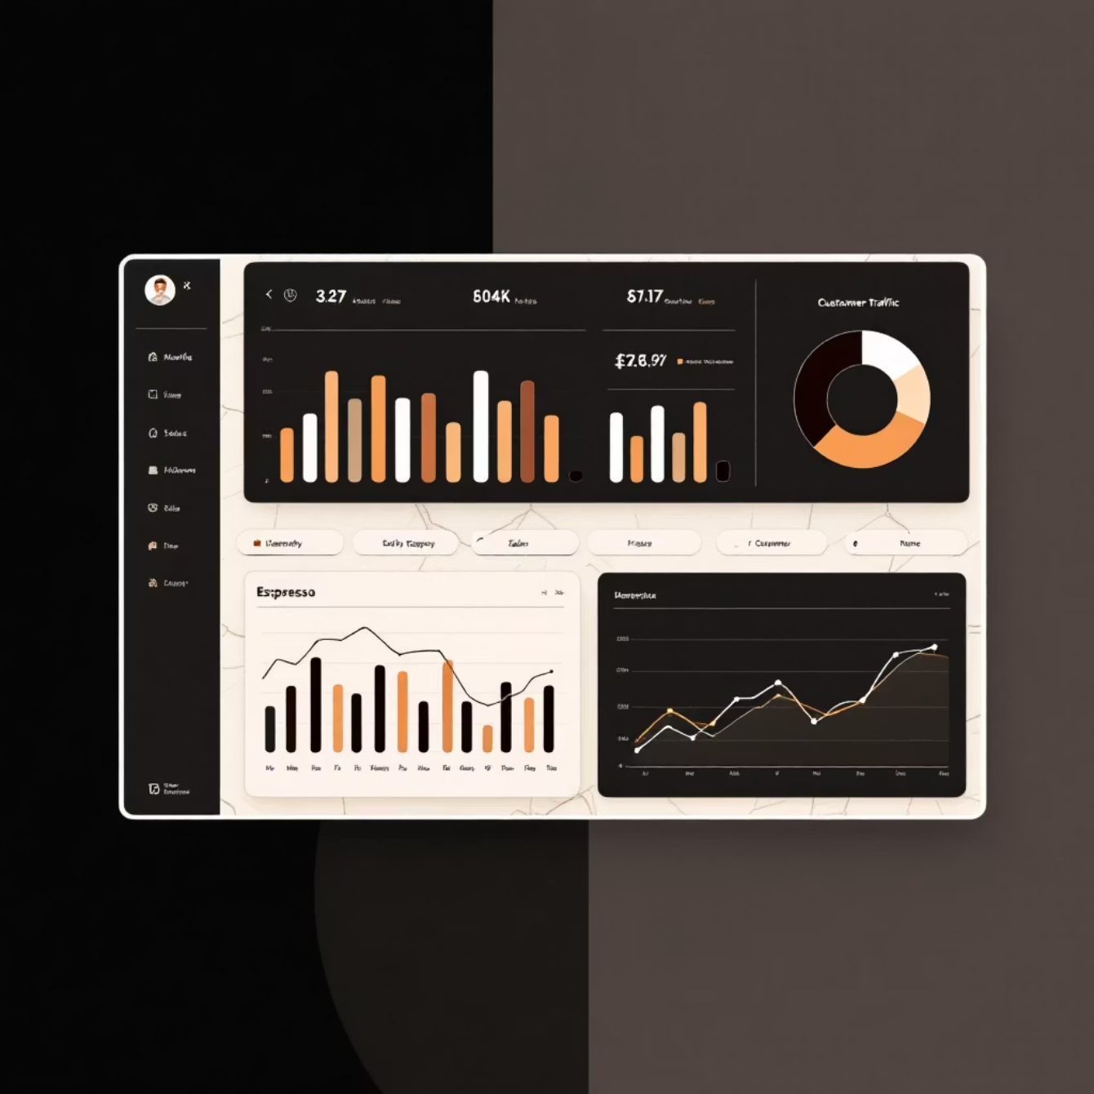
Sales Performance Insights
49,574
₹16.44
Total Quantity Sold
Average Pizza Price
Pizzas delivered across all categories and sizes during the analysis period
Mean pricing across all sizes and categories, indicating mid-range positioning
₹38.31
Order Value
Average revenue per order, reflecting typical customer purchase behavior
Category Performance Highlights
Best Performing: Classic category pizzas led sales volume with consistent demand across all time periods, indicating strong customer loyalty and preference.
Underperforming: Certain specialty categories showed lower sales, suggesting opportunities for menu refinement or targeted marketing campaigns.

Slide 8
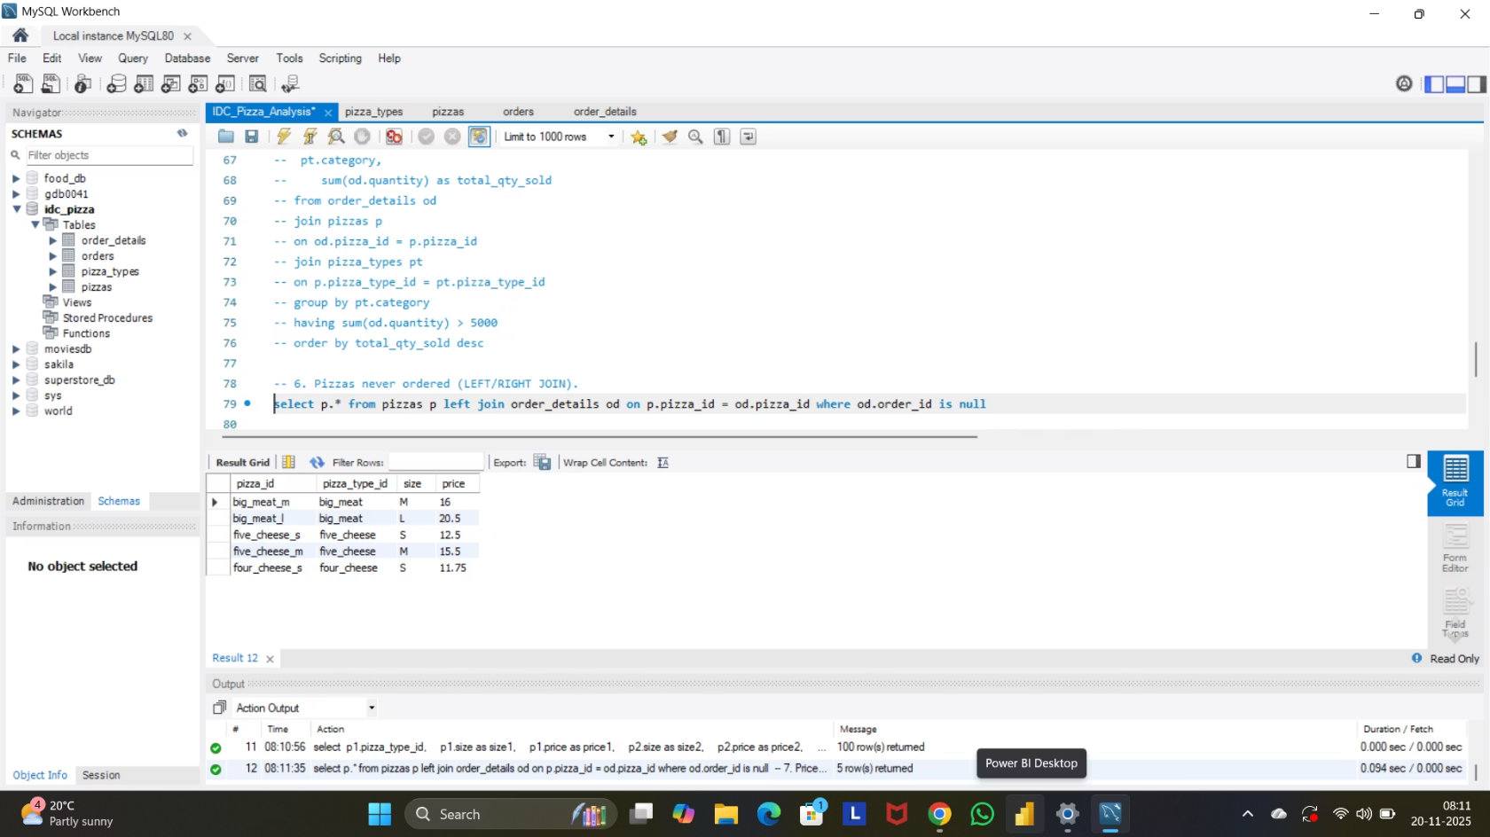
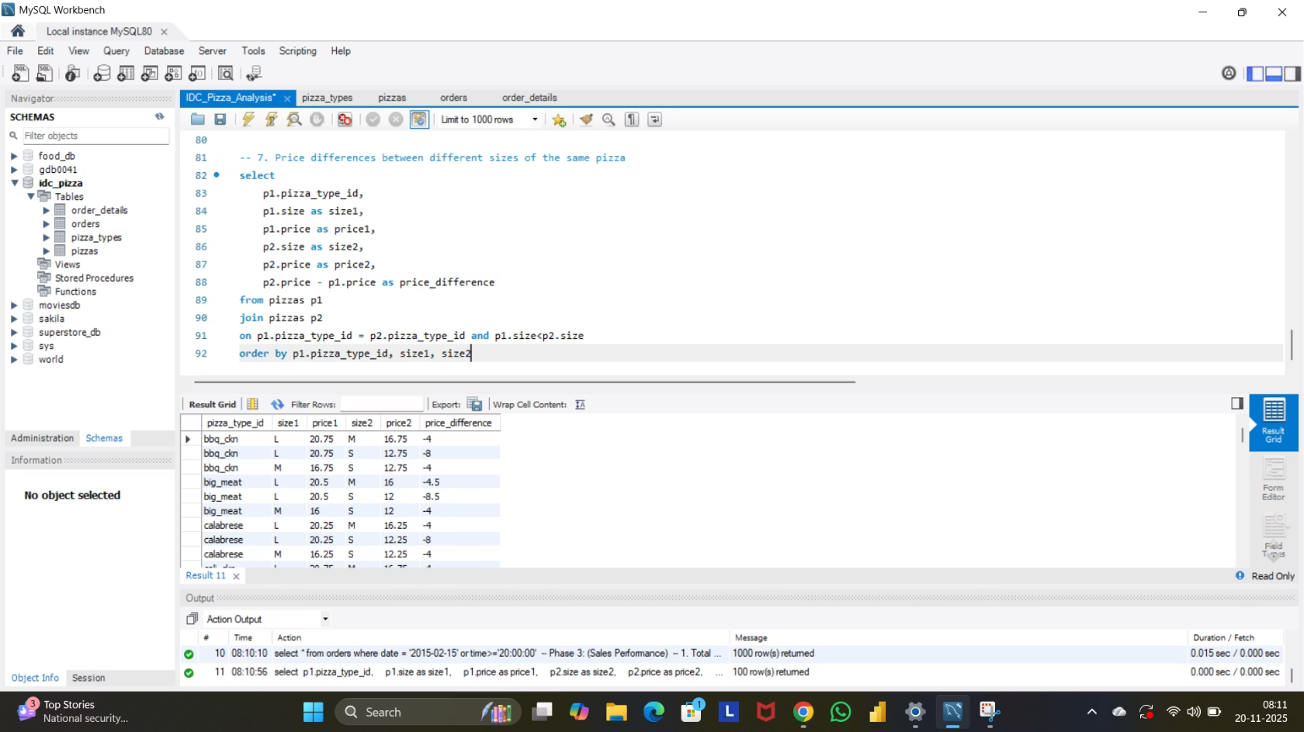
Advanced Findings
Menu Gap Analysis
Size Pricing Comparison
LEFT JOIN analysis identified pizzas that have never been ordered, revealing menu items that either lack appeal or require better visibility through marketing efforts.
SELF JOIN analysis compared pricing across different sizes of the same pizza type, revealing pricing strategies and identifying opportunities for margin optimization.
Business Impact: These findings enable data-driven decisions about menu streamlining, promotional focus, or product discontinuation.
Strategic Value: Price elasticity insights support dynamic pricing and value-based promotions.

Slide 9

Challenges & Learning Outcomes
1
Technical Challenges
Mastering complex multi-table joins across normalized schema
Handling NULL values and data quality issues
Date and time filtering with proper formatting
HAVING clause logic for aggregated filtering
SELF JOIN implementation for comparative analysis
2
Key Learnings
Writing clean, efficient SQL following best practices
Translating business questions into SQL queries
Deriving actionable insights from raw data
Identifying anomalies and data quality issues
Building structured analytics workflows
3
Professional Growth
Enhanced problem-solving and analytical thinking
Improved documentation and code organization
Developed business acumen for retail analytics
Strengthened communication of technical findings
Built portfolio-ready project for career advancement

Slide 10
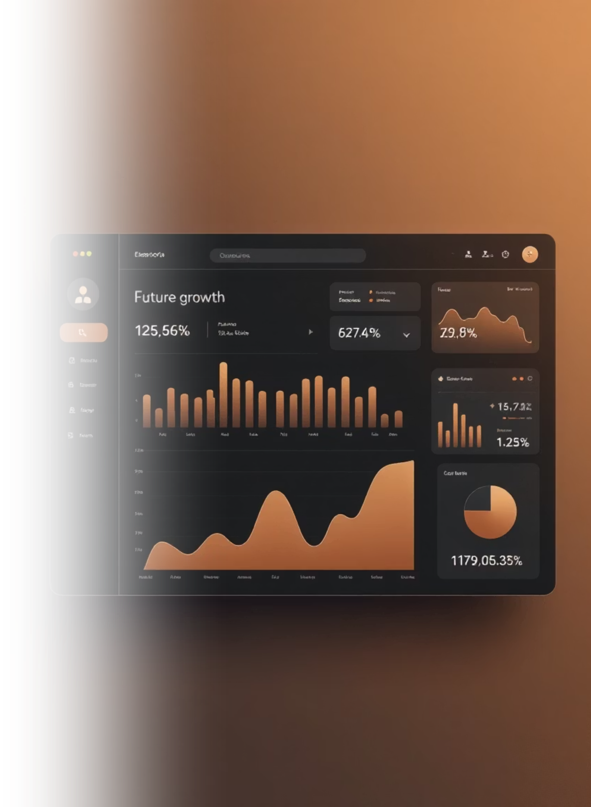
Conclusion & Next Steps
01
02
SQL-Driven Business Intelligence
Key Discoveries
Identified top-performing categories, optimal pricing structures, underperforming menu items, and strategic gaps—providing IDC Pizza with a data foundation for growth and operational efficiency.
MySQL analysis successfully transformed raw transactional data into clear, actionable business insights—revealing sales patterns, pricing behaviors, and performance metrics critical for strategic decision-making.
03
Future Analytics Roadmap
Build interactive dashboards for real-time monitoring, develop predictive models for sales forecasting, conduct deeper profitability analysis by ingredient costs, and implement customer segmentation strategies.
Project Impact: This analytics challenge demonstrates the power of structured SQL analysis in driving business value—turning data into decisions that optimize operations, enhance profitability, and improve customer satisfaction.

